Slide 1

GALGOTIAS UNIVERSITY PLOT NO.2, SECTOR – 17 A, YAMUNA EXPRESSWAY, GREATER NOIDA, GAUTAM BUDH NAGAR, U.P.,INDIA
SCHOOL OF COMPUTING SCIENCE AND ENGINEERING
CAT-3 CASE STUDY REPORT FILE SUBMISSION
ON
“ARTIFICIAL INTELLIGENCE IN MARKETING”
COURSE NAME : AI FUNDAMENTAL YEAR :1ST
COURSE CODE : BCS01T1002 SEMESTER : 1
SCHOOL : SCSE SESSION : 2021- 2022
PROGRAM : B. TECH
SUBMITTED BY: | SUBMITTED TO:
AVIRAL GAURAV (21SCSE1300029) | MRS. INDRAKUMARI
DEEPANSH BHATIA (21SCSE1011677)
NEERAJ SINGH (21SCSE1011675)
AMIT SINGH (21SCSE1410106)
ABHINAV KUMAR CHOUDHARY (21SCSE1011615)

Slide 2
WELCOME TO AI IN MARKRTING

Slide 3
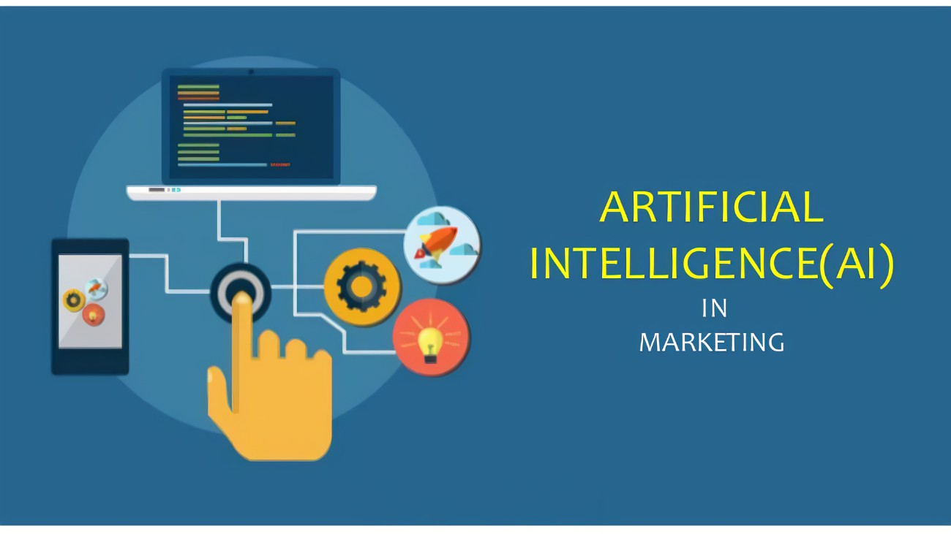

Slide 4
What is Artificial Intelligence (AI) Marketing?
AI marketing uses artificial intelligence technologies to make automated decisions based on data collection, data analysis, and additional observations of audience or economic trends that may impact marketing efforts. AI is often used in marketing efforts where speed is essential. AI tools use data and customer profiles to learn how to best communicate with customers, then serve them tailored messages at the right time without intervention from marketing team members, ensuring maximum efficiency. For many of today’s marketers, AI is used to augment marketing teams or to perform more tactical tasks that require less human nuance.
AI marketing use cases include:
Data analysis
Natural language processing
Automated decision making
Content generation
Real – time personalization

Slide 5
Components of AI in Marketing
It’s clear that artificial intelligence holds a vital role in helping marketers connect with consumers. The following components of AI marketing make up today’s leading solutions that are helping to bridge the gap between the expansive amounts of customer data being collected and the actionable next steps that can be applied to future campaigns:
Machine Learning
Machine learning is driven by artificial intelligence, and it involves computer algorithms that can analyze information and improve automatically through experience. Devices that leverage machine learning analyze new information in the context of relevant historical data that can inform decisions based on what has or hasn’t worked in the past.
Big Data and Analytics
The emergence of digital media has brought on an influx of big data, which has provided opportunities for marketers to understand their efforts and accurately attribute value across channels. This has also led to an over saturation of data, as many marketers struggle to determine which data sets are worth collecting.
AI Platform Solutions
Effective AI-powered solutions provide marketers with a central platform for managing the expansive amounts of data being collected. These platforms have the ability to derive insightful marketing intelligence into your target audience so you can make data-driven decisions about how to best reach them. For example, frameworks such as Bayesian Learning and Forgetting can help marketers gain a clearer understanding of how receptive a customer is to a specific marketing effort.

Slide 6
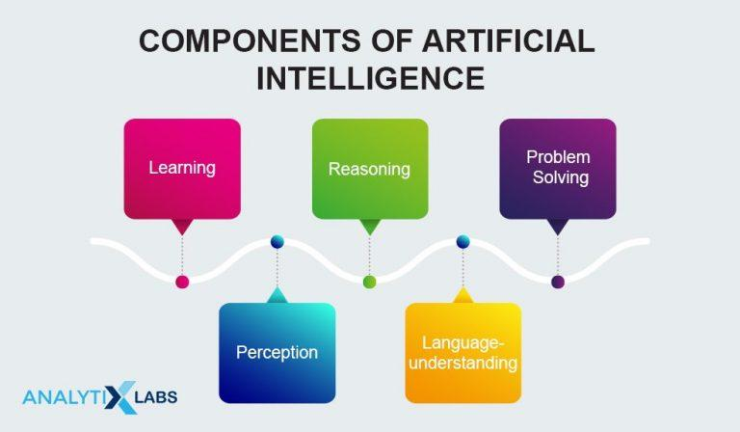
Components of ai

Slide 7
Benefits of AI in Digital Marketing
AI is the computer equivalent of an extremely powerful human brain. It uses algorithms to collect, analyze, apply and even learnt from data inputs. Human marketers can only do so much with all the data that is now available from digital channels. AI is much more efficient, and it is only growing more productive.
Using AI in digital marketing helps:
Maximum data collection
Visualize customer journey
Research customers
Personalize content
Identify trends in data more quickly
Provide a more convenient customer experience
Free up humans for more creative, critical thinking tasks

Slide 8
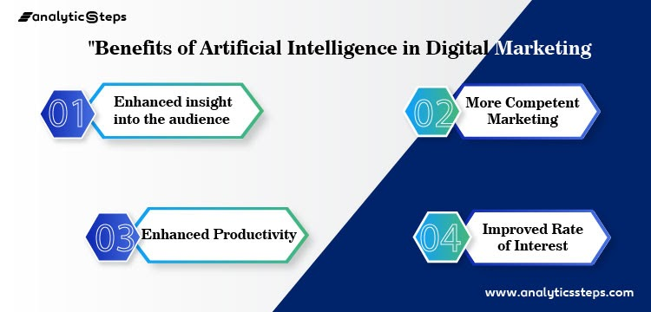

Slide 9
Uses of Artificial Intelligence in Marketing
1.Take Sales Forecasting to the Next Level:
AI takes conversion management solutions to the next level. Marketers can now compare sophisticated inbound communication side-by-side against traditional metrics to help answer difficult strategic questions. With AI marketing, there are no longer questions about whether or not a prospect is ready for a discussion, the data provides the answer.
2. Gain a Deeper Understanding of Your Consumers:
With AI solutions, marketers know exactly what consumers are thinking, saying, and feeling about the brand in real time.
3. Optimize Digital Advertising Campaigns:
While there are various ways to optimize digital advertising and account-based marketing, AI solutions help marketers take them a step further for deeper insight and analysis. AI can tap into the abundance of consumer data hidden in keyword searches, social profiles, and other online data, for smarter and more effective digital ads. The results are human-level outcomes and insights without the manual human labor.
4. Join Real-Time Conversations with Consumers:
This allows brands to interact directly with consumers in real-time through online conversations or events. Communicating with consumers at the precise ‘decision-making moment’ can help directly influence buying decisions. AI helps marketers monitor these social conversations and other open forums to identify any relevant conversations.

Slide 10
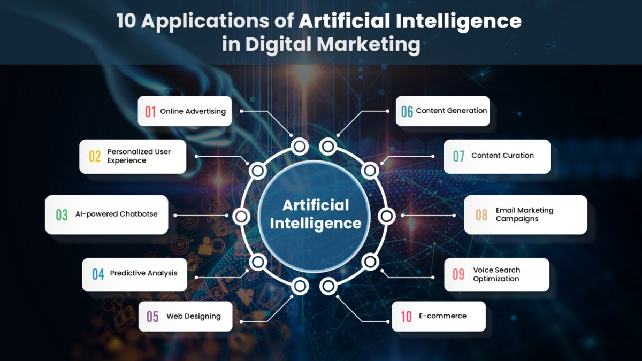

Slide 11
AI Tools That Will Change the Future of Marketing
AI is certainly a powerful marketing tool. What does it involve? Simply put, AI helps businesses solve one of the most important problems in today’s business: securing consumers. From the planning stage to the customer loyalty stage, AI plays a key role in the success of all marketing campaigns. As a result, organizations that take full advantage of AI will have an edge over their competitors.
Here are some AI tools that you n=should checkout for help :
Google Could AI
HubSpot
Atomic Research
Cortex
Chatbots and AI almost always come together in the context of maintaining customer relations and digital marketing. WotNot enables automation and enhanced customer management for a win-win situation for both the customers and the service provide

Slide 12
Conclusion
In conclusion, Some people have a big doubt that AI is going to overshadow Digital Marketing. And we want to conclude that Digital Marketing and AI are going to join hands to bring outstanding outputs. Beyond this, Artificial Intelligence is going to bring more and more changes to digital life.

Slide 13
Thank You

